Slide 1


Slide 2


UBS PITCH 2023
Team: Number Crunchers
Stevens Institute of Technology
UBS Mentors:
Shirly Piperno
George Sorial
Team Members:
Aayush Vikram Singh
Abhimanyu Sheth
Manvendra Shrimal
Priestley Fernandes
Theophilus Ijiebor

Slide 3

Our Mission
Help investors make informed investment decisions by finding balance between risk adjusted returns and ESG alignment and devise ways to promote sustainable practices.

Slide 4
Mission ESG
EDUCATE
INNOVATE
OPTIMIZE

Slide 5
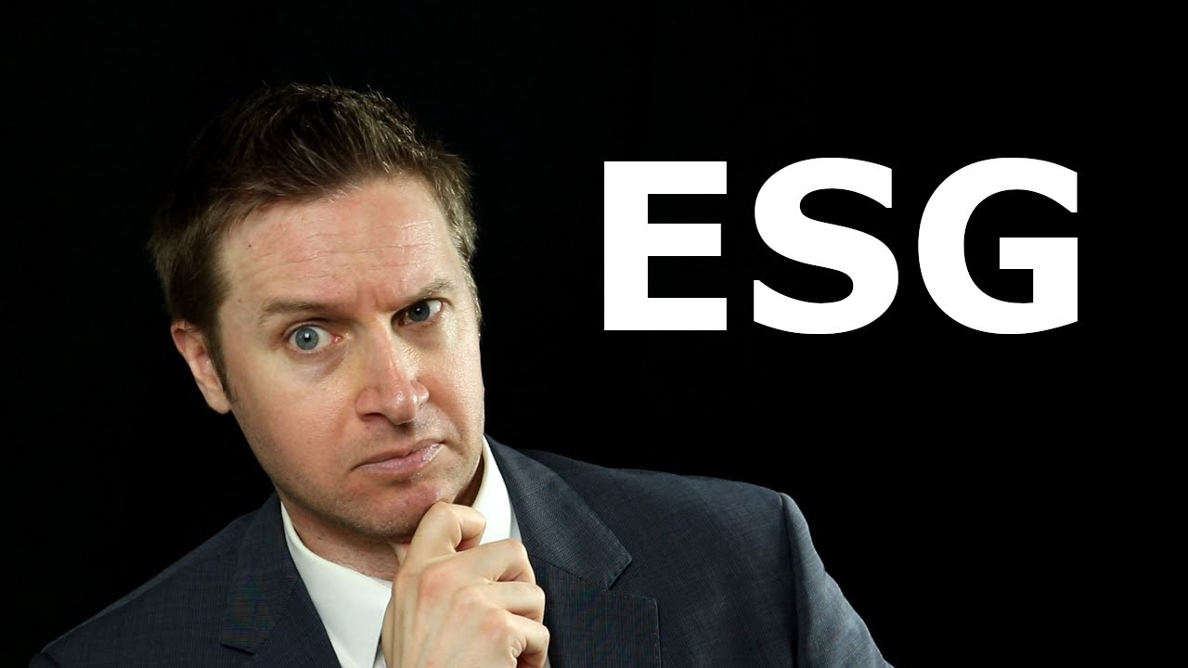
The Problem Statement
Develop a model for constructing investment portfolio that systematically incorporate ESG risks to enhance risk-adjusted returns, align with investors’ expectations, and adhere to ESG evaluation guidelines

Slide 6
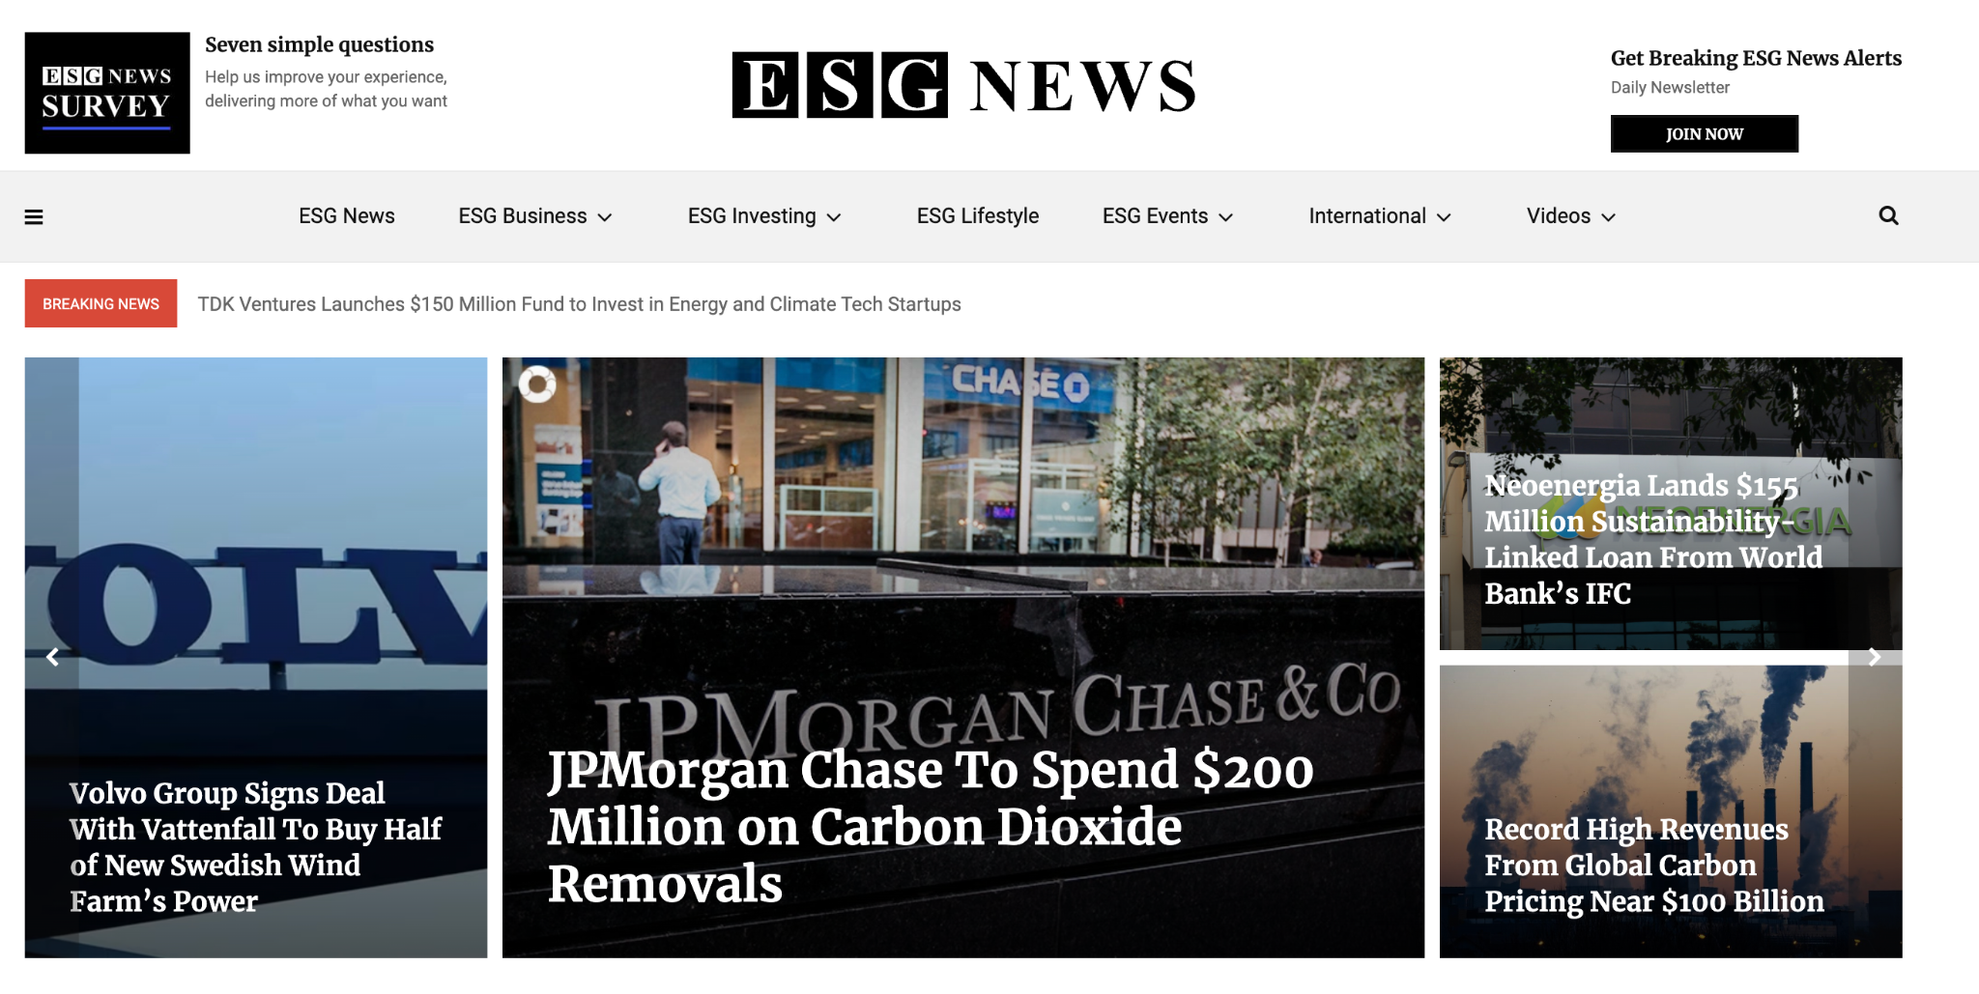
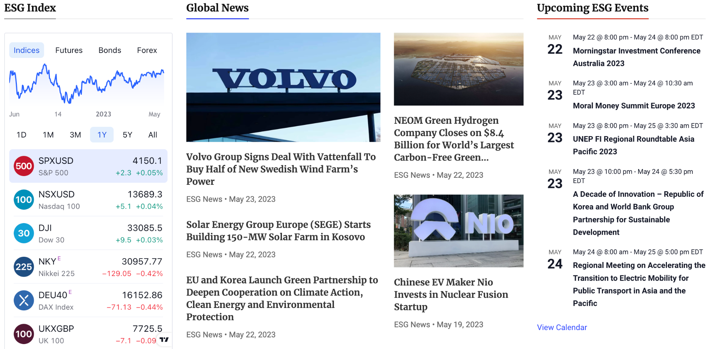

Slide 7
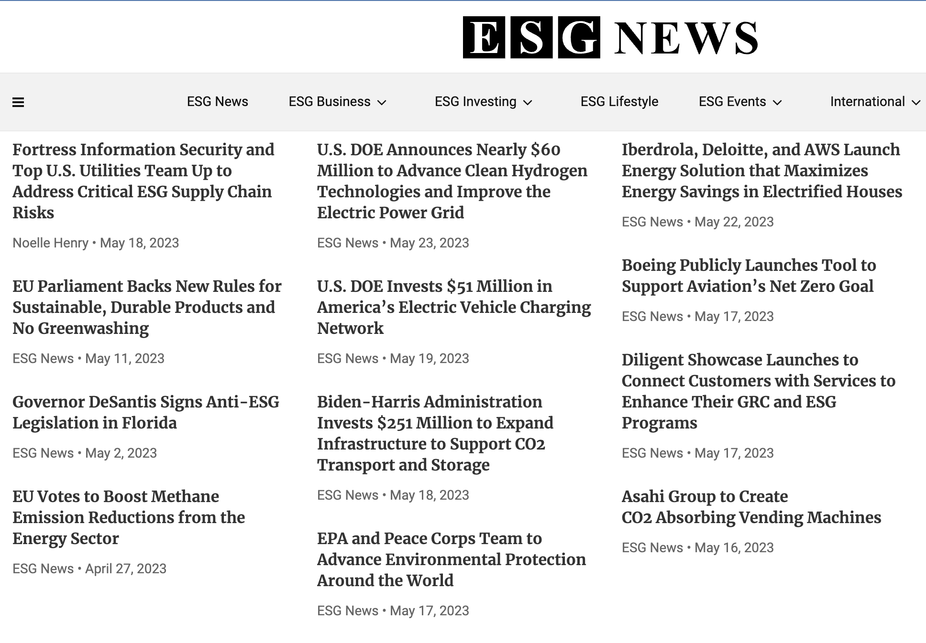

Slide 8
What is ESG?
The term ESG was coined in 2005 because of former UN Secretary General Kofi Annan forming a joint initiative under United Nations Global Compact with the International Finance Corporation and the Swiss Government
ESG is a framework that helps stakeholders understand how an organization is managing risks and opportunities related to environmental, social, and governance criteria (sometimes called ESG factors).
Based on public disclosures like annual reports and sustainability reports
E – Company’s Environmental stewardship ; S: Social factors; G: Corporate Governance

Slide 9
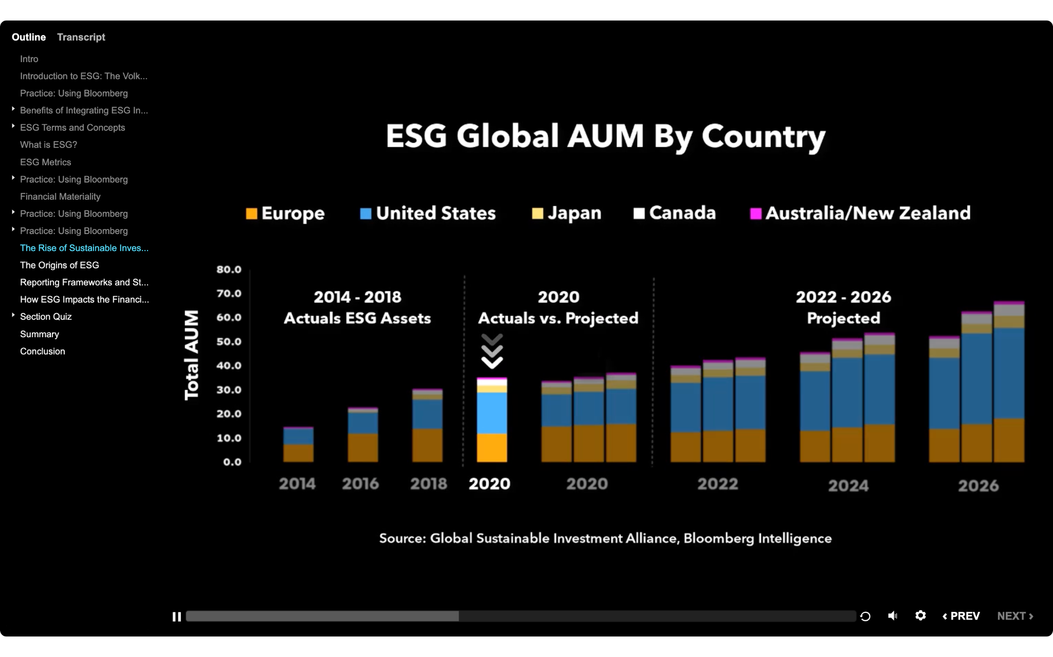
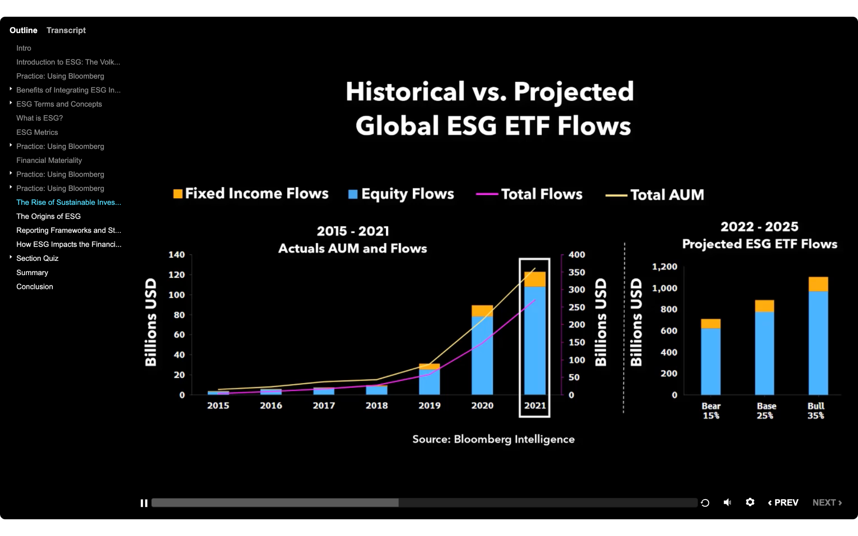
The Market

Slide 10
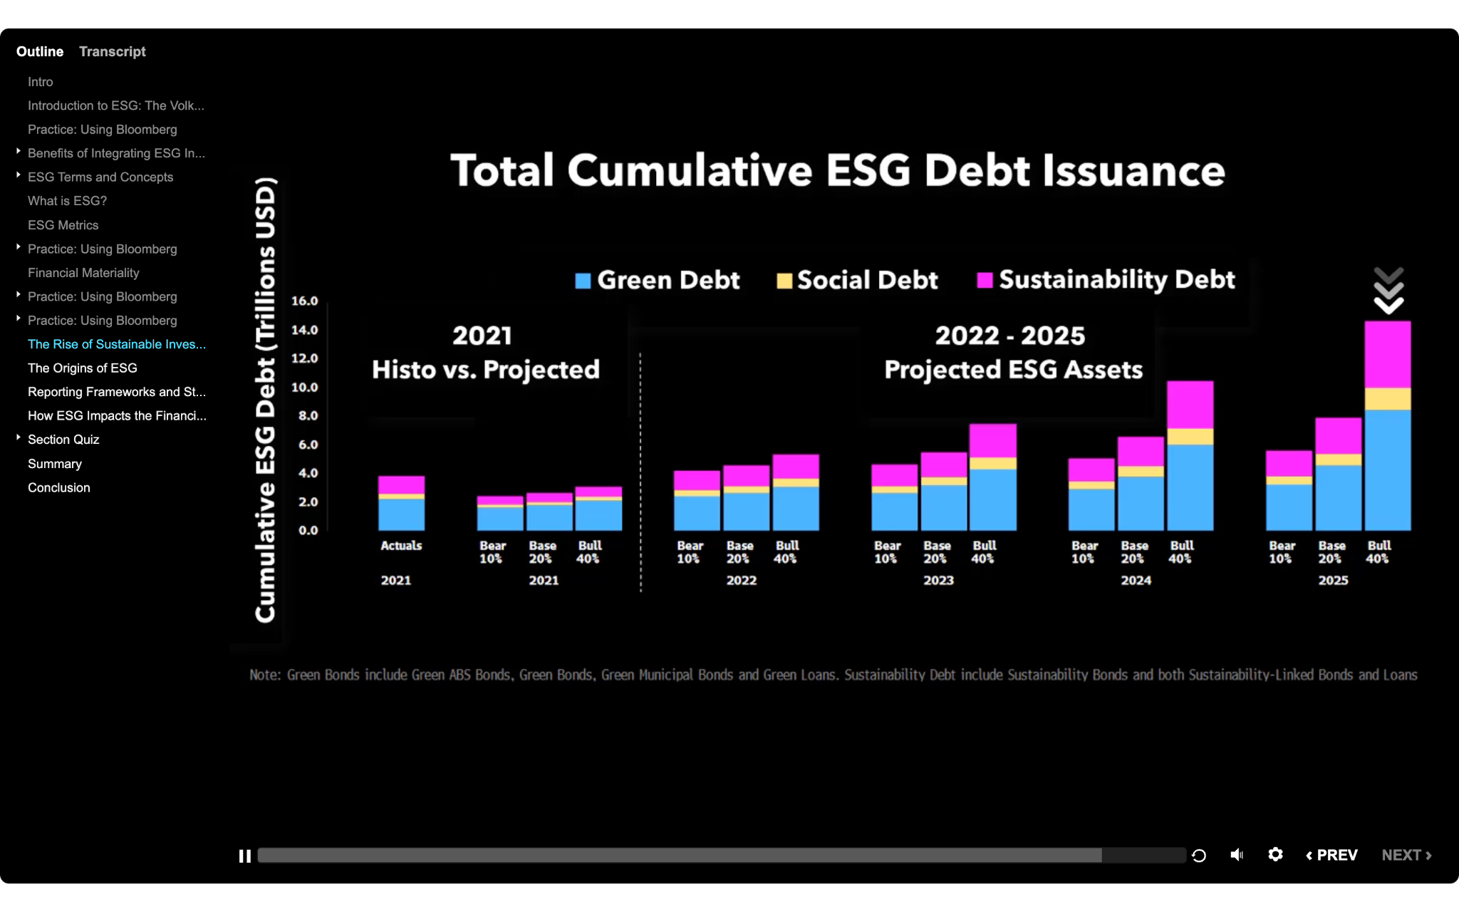

Slide 11
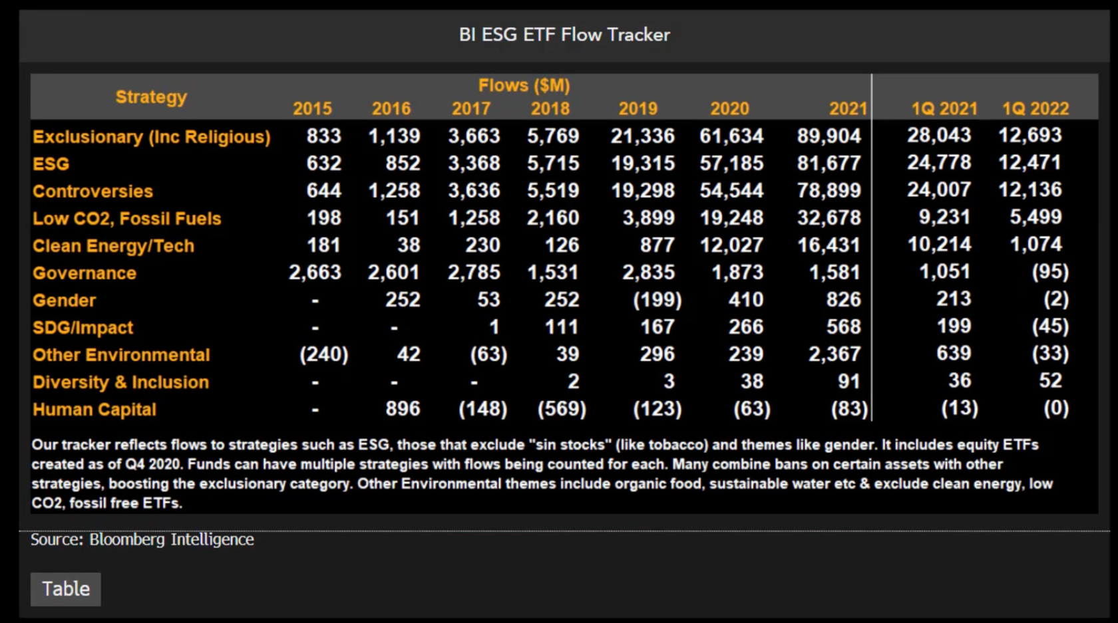

Slide 12

Target?
USA has a lot of potential with a high projected growth in coming years
Gen Z and Millennials account for 43% and 49% of the U.S. and global population, respectively. A recent survey by asset management firm Amundi and the Business Times found that 82% of Gen Z and close to two-thirds of young millennial investors have exposure to Environmental, Social and Governance (ESG) investments
Family offices, investors with institutional needs, entrepreneurs and ultra high net-worth individuals can be best prospects. Government and similar institutions can be looked out for

Slide 13

IDEAS
A chatbot for ESG awareness
New metric compatibility along with predefined metric (ESG score) from Bloomberg
Customer Centric Approach
Portfolio optimization considering ESG

Slide 14
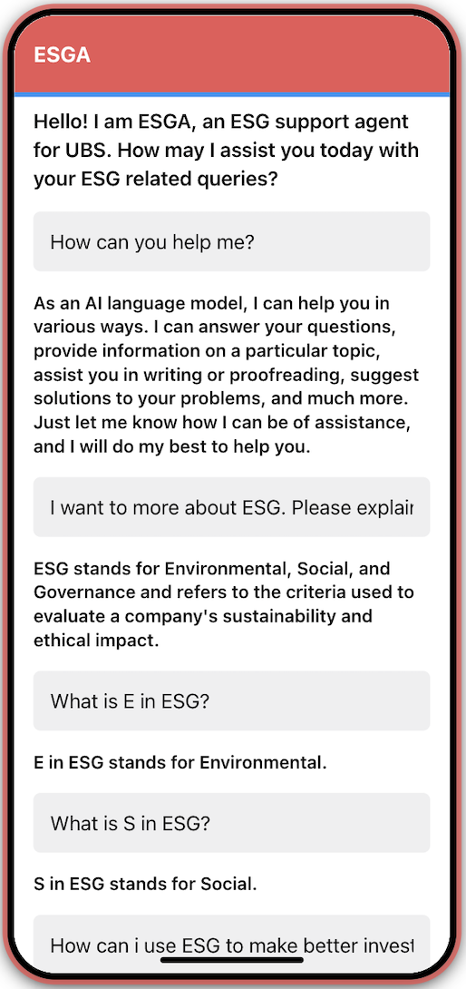
Meet ESGA!!!

Slide 15
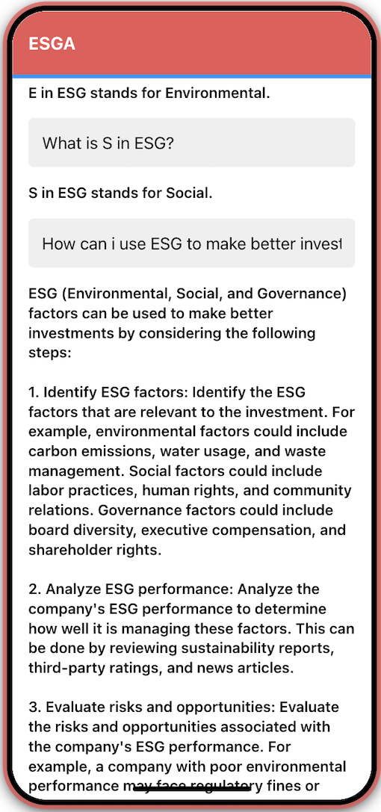
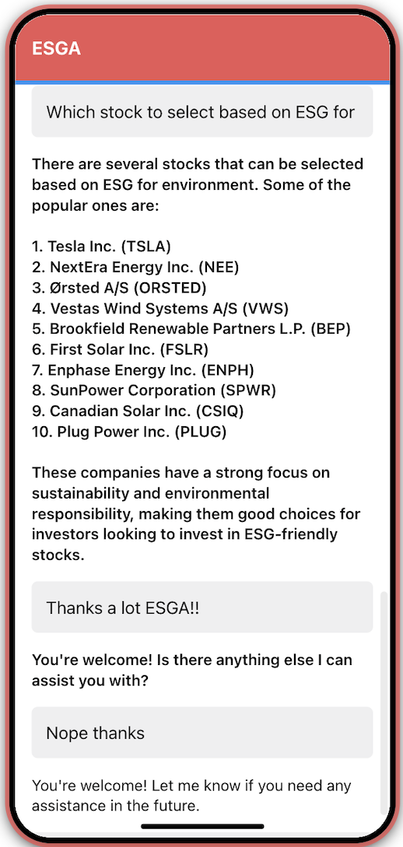
Built using Retool, a no-code web development platform
Integrated with Azure OpenAI Cognitive Services
Uses the gpt-3 turbo engine
ESGA can be trained to handle specific ESG related queries
ESGA can answer queries which can help user to get some basic information before investing

Slide 16
Social Feedback Mechanism
Derived from an idea from the paper ‘Mining Brand Perceptions from Twitter Social Networks’ by Aaron Culotta and Jennifer Cutler (March 2023)
The method involves using the core idea of forming attribute specific company perception ratings using the social connections of an organization on Twitter
Homophily: The method involves using the core idea of forming attribute specific company perception ratings using the social connections
of an organization on Twitter
The proposed approach aims to infer the perceived strength of a brand for a given attribute based on the extent to which its follower set overlaps with a large set of accounts that exemplify the attribute.
The output will be a metric capable of deciphering the strength of association between company and attribute specified.

Slide 17
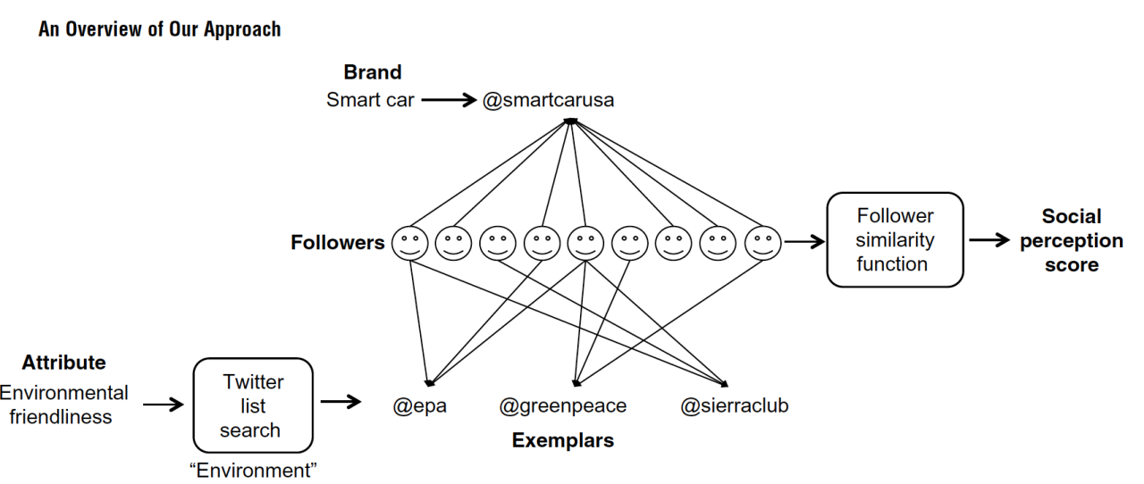
Social Feedback Mechanism

Slide 18
Methodology
01
Identify the company or stock
02
Collect the exemplars related to an attribute
03
Fetch the list of followers of the company and exemplars
04
Use Jaccard Similarity Index to find common followers
05
Use or transform this score for further applications

Slide 19

Just a demo!!!
Used Phantom Buster, a no-code cloud based task automator software to scrape the list of followers to demonstrate a small use case
Considered a use case for clean technology or environment focused exemplaries
Due to limitations, fetched 200 -250 followers for each account and restricted the number of exemplaries to 20. Some of the exemplaries selected are:
Greenpeace International
Global Sustainability Standards Board
Forum for the Future
Sierra Club
Rainforest Alliance
NRDC (Natural Resources Defense Council)

Slide 20
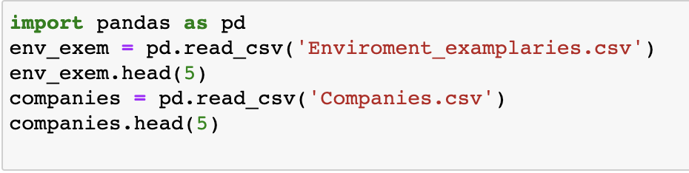
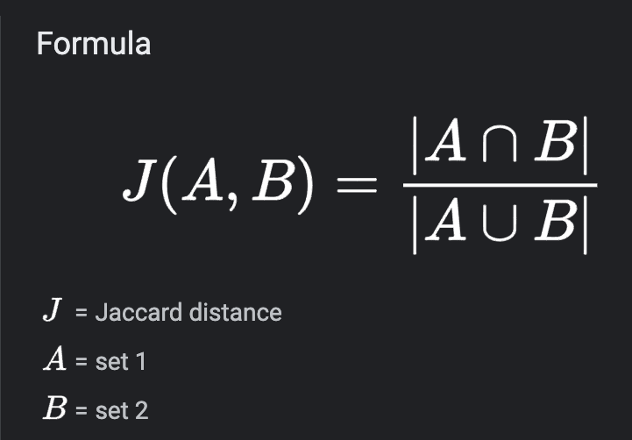
Results
COMPANY | SCORE | COMPANY | SCORE
Tesla | 0.0 | Orsted | 1.32
Siemens Gamesa | 1.32 | First Solar | 2.2
Vestas | 1.32 | Enphase Energy | 1.98
Schneider Electric | 0.881 | Alphabet Inc. | 0.22

Slide 21
SFM : The BIG picture
The paper prescribes a big data approach where the process is automated for large scale scraping
Twitter Lists were used to programmatically collect exemplar accounts for each attribute as follows
Iterated through the first 50 List results and retained accounts that appeared on at least two different Lists (to reduce the number of false matches).
Introduced a modification to encode the intuition that being similar to niche exemplars is more important than being similar to popular exemplars.
Many ways can be used but weights in this case were assigned to each exemplar inversely proportional to its number of followers.

Slide 22
SFM : The BIG picture (Survey)
List of 239 brands and three attributes
The surveys were conducted through Amazon Mechanical Turk (AMT), which had been shown to be a reliable source for social science data collection
List of 239 brands and three attributes was used for analysis
Brands were grouped into sets by sector and attribute, and 500 AMT participants were recruited to rate each set.
Participants were asked to rate each brand in the set on a scale of one to five according to how much they believed the brand aligned with the perceptual attribute at hand

Slide 23
SFM : The BIG picture (Results)
To evaluate the overall accuracy of SPS, each sector-attribute combination was examined individually and Pearson correlation coefficient between the average survey ratings and the SPS was calculated
Across all sectors and attributes, the average correlation coefficient between SPS and the survey averages is 0.72
Since its a novel technique, there is no clear external benchmark to directly compare performance against. In their validation, a similar kind of technique had correlations between their estimates and survey results that ranged from 0.43 to 0.55.
A small correlation coefficient of 0.107 (p D 0006) indicating that attribute ratings were not reflections of popularity.

Slide 24
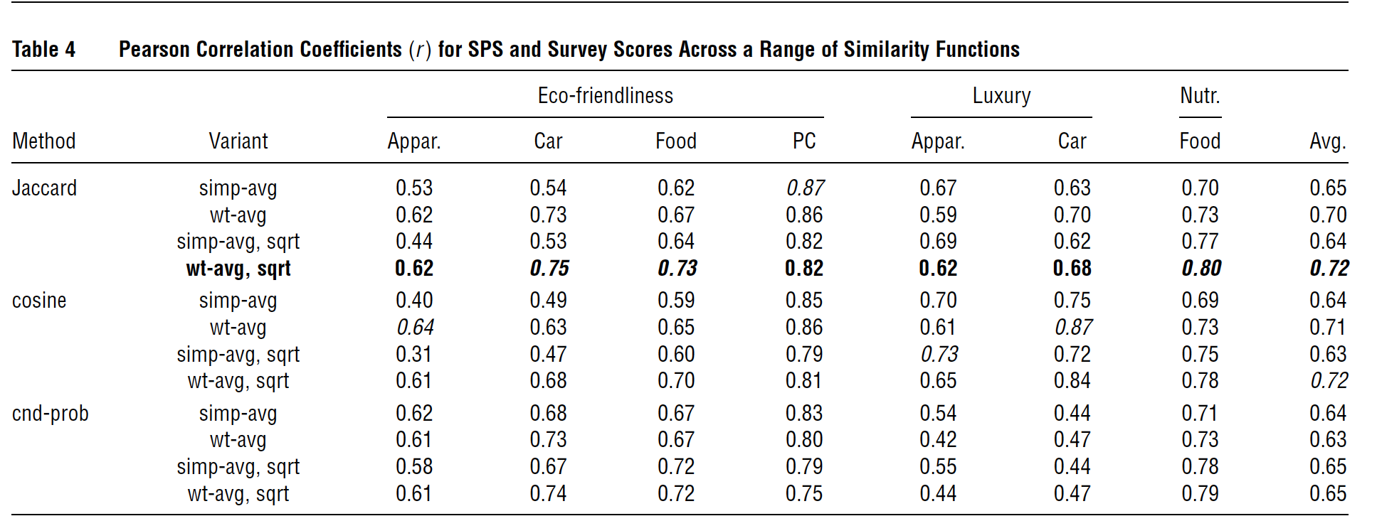
Why Jaccard Similarity Index?

Slide 25
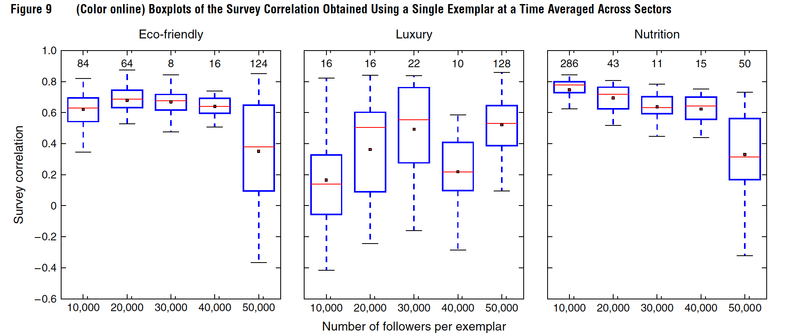
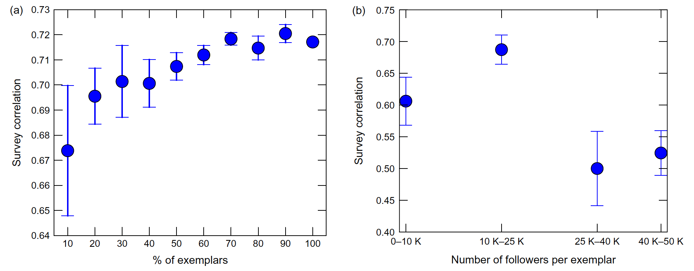

Slide 26
Asset Allocations under ESG

Slide 27
Overview
Our model takes into account the risk adjusted returns for stocks which have a high ESG rating
For selection of stocks we have selected high growth value stocks over the last five years
These stocks have a AAA ESG Rating according to the MSCI ESG index which makes them the some most highly rated stocks amongst all the Economic Social and governance metrics which contribute to ESG
ESG as a methodology is meant to mitigate risk by allowing investors to select stocks and assets which beat systemic risk by having a high contribution to sustainability metrics

Slide 28
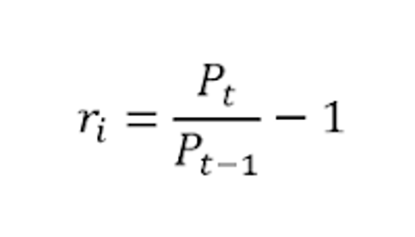
Methodology
Data for the stocks has been taken from Yahoo finance for the last 10 years for all the stocks
Performance metrics were calculated using Log Returns as our time series

Slide 29
Methodology
After calculating the log returns we calculated the the risk adjusted returns for the
portfolio.
We then divided the two to get our risk adjusted returns for that particular stock, the code for pour methodology is in the following slide
Risk-adjusted return is a calculation of the return (or potential return) on an investment such as a stock or corporate bond when compared to cash or equivalents
For our Risk adjusted Returns Calculations we calculated the total returns (mean) and the total volatility(variance) for the stock

Slide 30
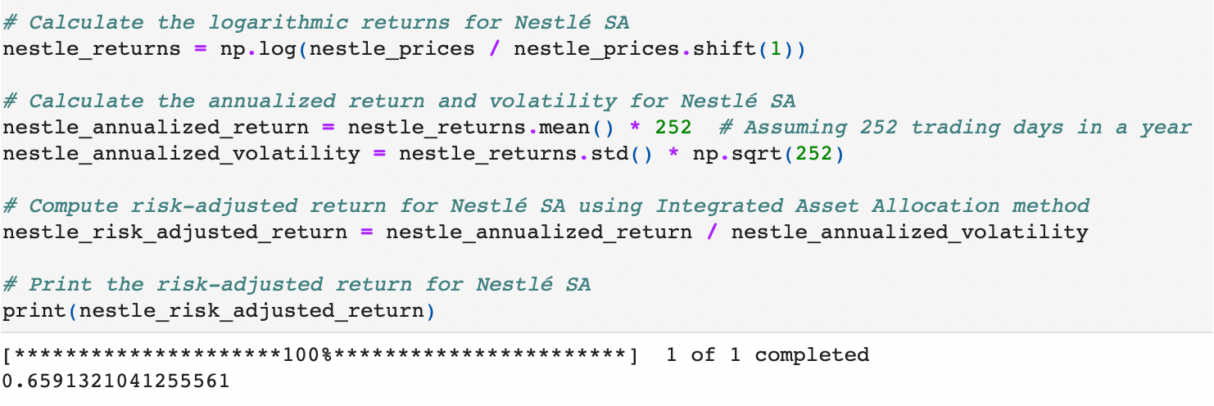

Slide 31
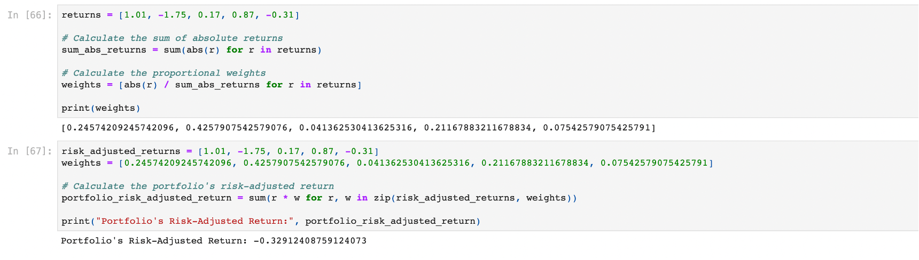

Slide 32
We the used the individual returns of these stocks to calculate their weight in our portfolio
As can be seen the more profitable stocks are given a higher weigh and the loss making stocks are assigned lower
These stocks are all have a lower risk exposure owing to their high ESG which we found in keeping with our overall research
Large cap market leading companies often have a high ESG scores owing to the fact that a low ESG scores could potentially be detracting to investors who are so inclined

Slide 33
Use of Media Analysis (SFM)
The selection for stocks for this model were made using the classic portfolio theory and analytics methods such as the mean variance model
Our social media criterion can further help enhance our selection by adding components that the current ESG command cannot grasp
If a particular stock or company gets a poor social media score according to our model then the weight of that asset could be adjusted in our portfolio or it could be omitted overall from our selection basis
We can use the analysis to weed out companies that could impact negatively on our ESG selection or our overall returns and risk exposure.

Slide 34
THANKYOU!!!

